Slide 1
Nutritional Assessment
Presented by:
Elementary Schools
Hispanic Cultural concentration
The Southern and Western Region

Slide 2

Introduction
Purpose
Nutritional menu comparison
Revision for healthier choices based on age and culture
Age Group Focus: ages 5-10 years
Elementary Schools
Cultural Concentration
Hispanics
South and west region
Notes:
Research have shown children of hispanic origin experience higher rates of obesity than do non-Latino white children. Overweight and obesity, are defined as body mass index at or above the 85th percentile for age and sex. It is stated that in the United States during 2011 and 2012, the prevalence of overweight and obesity was 38.9% for Latino, 35.2% for non-Latino black, and 28.5% for non-Latino white children aged 2 to 19.(Kaiser PhD, Martinez Ms, & Horowitz, 2015) It is safe to say these children have a risk factor for nutrition-related chronic diseases including type 2 diabetes.
The purpose of this presentation is to review, analyze, and compare different menus from elementary schools within the hispanic cultural concentration in the South and West region of the United States. We will be analyzing these menus, one from each region, that consist of breakfast, lunch and dinner for children ages 5 - 10 years to see how healthy they are; if they are appropriate for the group’s nutritional requirement , the cultural influence and how well we can modify each one to add more nutritional value.

Slide 3


West Coast
West Covina (California) Elementary School Breakfast Menu

Slide 4

Current Menu Analysis (West Covina Elementary) California Breakfast
Healthy Selections: Fresh banana, Juice variety, Cereal variety, Fresh grapes, Apple slices, and Strawberry yogurt
Unhealthy Selections: Cinnamon roll, Cinnamon glazed french toast, bean/chorizo breakfast burrito, graham crackers
Example: Graham Crackers versus Fresh grapes
Graham crackers: 115 kcal, 96.19mg of sodium, 7.09g of sugar, 3.37g of trans fat
Fresh grapes: 45 kcal, 0 trans fat, 8 mg of sodium
Notes:
This slide will be analyzing the Elementary school breakfast menu for West Covina, California. In order to lower obesity rates in the United States, it is vital to start young. Accustoming children to healthy eating at a young age will prove long term benefits in their eating habits as adults. According to the U.S. Census Bureau (2010), “53.2%” of those living in West Covina are “Hispanic or Latino”. Naturally, you will encounter foods that are culturally influenced by the Hispanic/latino culture in this area of concentration such as beans, burritos, and empanadas. This menu incorporates more variety for traditional hispanic foods than the South Florida Menu shown in the upcoming slides. This menu also fuses a vegetable called “Jicama” which is a mexican yam/ turnip. These options are all shown in West Covina’s Lunch menu. For this menu, the healthy selections provide meals lower in saturated fats, sodium, sugar, and kcals than the unhealthy options. The unhealthy selections provide meals very high in saturated and trans fats, sugar, calories, and sodium which will not meet the nutritional needs of the children. The unhealthy options are low in vital nutrients such as calcium and vitamin D that children of this age group need to meet their developmental requirements.

Slide 5
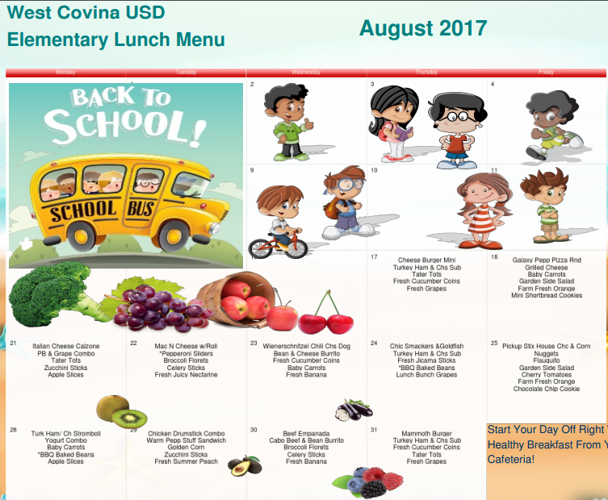

West Coast
West Covina (California) Elementary School Lunch Menu

Slide 6

Current Menu Analysis (West Covina Elementary) California Lunch
Healthy Selections: Turkey Ham and Cheese Sub, Fresh Banana, Garden side salad, PB and Grape sandwich, Broccoli Florets, Golden corn
Unhealthy Selections: Chili Cheese Dog, Cheeseburger minis, bean and cheese burrito
Example: PB and Grape versus Cheeseburger minis
PB and grape: 290 kcal, 2.5g saturated fat, 350mg sodium
Cheeseburger: 318 kcal, 6.1g saturated fat, 770mg sodium
Notes:
West Covina’s Lunch Menu provides a variety of options for children to attain adequate nutritional needs. However, some foods such as the unhealthy selections listed, should be avoided. The unhealthy selections are very high in sodium, saturated fat, and calories and could easily be changed for healthier options. As shown above, A peanut butter and Grape sandwich makes for a much healthier option than the cheeseburger while also being about the same portion. By analyzing food labels and switching around certain foods, elementary school children can get the proper nutrients they need to grow.

Slide 7


South Florida Breakfast and Lunch Menu
Ben Gamla Charter School
K-8
Hollywood, FL

Slide 8
Current Menu Analysis (Ben Gamla Charter School) South Florida Breakfast/Lunch
Healthy selections (Breakfast): Seasonal fresh fruit, Milk, Fruit juice and Granola bar
Healthy selections (Lunch): Green beans, Fruit, Vegetables (carrots, broccoli, green beans, peas, corn), Baked beans, and Salad with dressing
Unhealthy selections (Breakfast): Bagel and cream cheese and Cold cereal
Unhealthy selections (Lunch): Hot dogs on a bun, Macaroni and cheese, Pizza, Grilled cheese, Baked Ziti, and Chicken Nuggets
Example: Bagel and cream cheese versus Granola bar
Bagel: 436 calories, 4g saturated fat, 634 mg sodium, 27 mg of cholesterol
Granola bar: 132 calories, 0.7g saturated fat, 82 mg sodium, 0 mg of cholesterol
Notes:
Ben Gamla Charter school is located in Hollywood, Florida (South Florida). According to the U.S. Census Bureau (2010), “28.7%” of those living in Hollywood are “Hispanic or Latino”. This menu shows little variation for hispanic/latino foods. There should be more variety in order to appeal to the large hispanic concentration in that area. Options include, but are not limited to, beans (black, kidney, pinto), fruits (jicama, banana, pear), chicken quesadillas with whole wheat tortillas, and avocado. These are all great sources of nutrients such as fiber, protein, and healthy carbohydrates. For this specific menu, there should be less of a focus on unhealthy carbohydrates such as Macaroni and cheese, pizza, and grilled cheese. This provides many empty calories for children who are in their most important stages of development and foods high in sodium as well. Some of the healthy options would include milk and granola bars, although the menu doesn’t list specifically which type, the milk should be low-fat/skim and the granola bars should have more fiber and protein and less sugar and calories. Granola bars with fruits and oats would be a good option. As for main courses, foods with a concentration on protein and calcium such as the whole wheat chicken quesadillas previously mentioned, would give these children the nutrients they need. Other options would be beans, vegetables, fruits, chicken or fish, and whole grains.

Slide 9


Sample Menus
West Covina, California
Breakfast | Oatmeal, whole wheat toast, apple, low fat chocolate milk
Lunch | Peanut butter and grape sandwich, Jicama sticks, yogurt, orange juice, oatmeal cookie
Dinner | Broccoli and spinach, grilled fish and sweet potato, water
Notes:
Age considerations for the elementary school group (ages 6-12 years) would be to provide foods high in “calcium, magnesium, potassium, and fiber” (Philadelphia, T.C. 2014) Also, it is important to serve breakfast even when it’s rushed. Children could grab an apple and chocolate milk from the cafeteria on their way to class if they are in a hurry. These foods will provide children with the essential vitamins and minerals they need such as calcium, vitamin A, vitamin D, vitamin C, and dietary fiber. Other considerations are to monitor for food allergies/intolerances and to assess if the child has an order for a special diet such as puree, mash, or liquid. If children do not meet or exceed their nutritional requirements, some potential health concerns that may arise include childhood obesity, malnutrition, and diabetes (type 1 and 2) (Doheny, K. 2010). As far as cultural influences for the Florida and California Menus, food consumed by the students vary according to region and different cultures. Some examples include the Mexican, Cuban, and Venezuelan cultures. For the California menu specifically, we decided to leave Jicama sticks (Mexican yam) as shown in the original menu because they provide a healthy integration of cultural foods. The regional pattern shown in these menus reveals that there is an influence of the hispanic culture but with that comes food high in saturated fats and carbohydrates such as chili dogs and hamburgers. Our sample menu provides healthier options concentrated in calcium, iron, and fiber such as the PB&G sandwich and orange juice.

Slide 10
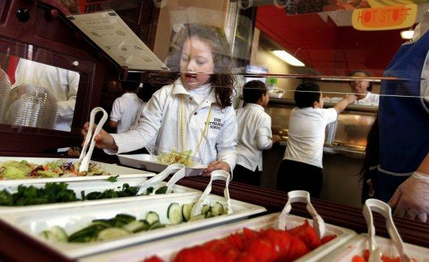

Sample Menus
Hollywood, Florida
Breakfast | Oatmeal, whole-grain cereal with low-fat milk and greek yogurt
Lunch | Whole wheat chicken quesadilla with low fat cheese, Green leafy salad with avocado, 1 cup of fresh fruit, fresh orange juice, and an oatmeal cookie
Dinner | Turkey burger on a whole wheat bun, baked sweet potato fries, and water
Notes:
The sample menus provided are better nutritional options because they contain essential nutrients such as calcium found in low-fat milk, whole grains in cereal, fiber in fruits and vegetables, protein in turkey, and iron in dark leafy greens. Whereas the original menus are filled with fast foods and empty calories such as chicken nuggets, pizza, and burgers. These foods are high in salt, saturated fats and low in fiber and nutrients. By replacing these foods with healthier nutritional options that provide Vitamins A, C, D, protein, whole wheat, iron, and complex carbohydrates children will begin to form better eating habits and develop a healthier diet to give them the energy and proper nutrients needed for their development.

Slide 11
Menu comparisons/original vs. sample selections
The original west Covina food choices have more carbohydrates and fat , than that of our sample menus. For example the cinnamon toast, burritos, and the graham crackers do not contain much nutritional vitamin and minerals like those of the sample menu, ,which contain more complex carbohydrates rather than refined, in addition to essential vitamins and minerals such as vitamin A, C, and calcium. (ChooseMyPlate, 2016)
Whole wheat toast, oatmeal, apple,and low fat milk have less fat and have pure, less processed carbohydrates and more leafy greens such as broccoli and spinach.
The Original Florida menu has foods that are also high in saturated fats and sodium such as hamburgers, pizza, and chicken nuggets. By replacing these foods with whole wheat breads, turkey, avocado, and leafy greens, children will have a variety of healthy nutrients to meet their nutritional requirements such as grains, proteins, carbohydrates, and fiber.
Notes:
Saturated fat, sodium, along with sugars are important to take into consideration . Sodium and saturated fats are found in most foods, especially those that are processed. This is why healthy food selections are important to take into consideration. Children who lack essential nutrients are at risk of improper development and inaccurate growth if they do not have a balanced diet.
Florida: The whole wheat chicken quesadilla provides a healthy alternative to a typically hispanic food. The Florida menu lacks foods with cultural influence so that will make a perfect addition to the menu. It offers an option with protein, fiber, and calcium.

Slide 12

Dietary Choices
Food choices: Sources of fiber & vitamin A/C/D,
Calcium & necessary carb portions for breakfast such as Seasonal fruit, oatmeal, low fat milk, Juice, and Whole grain cereal
Lunch: protein, carbs, leafy greens for fiber, vitamin A/C/D/K such as turkey, broccoli, spinach, fish, and sweet potato
Notes:
Fruits, vegetables, grains, and proteins are all major sources of essential nutrients that the body needs. Lack of these nutrients can cause deficiencies especially in adolescents who are in their most important stages of development. Fruits should be fresh, vegetables should be of variety and include dark green leafy, red, orange, and legumes. Proteins should come from lean meats and grains should be of whole complex grains that aren't refined.

Slide 13

Barriers
Cost
Changing established habits
Time
Cultural awareness
Notes:
In present day society, junk food tends to cost less than healthy options (Newell, L. 2015). Many schools have cut budgets towards their nutrition programs and seek alternatives. At times, these alternatives may not be the healthiest and that is why we come across food choices such as chicken nuggets versus chicken breast. There are also not many options for red meats as these food tend to be higher in cost. Schools are attempting to provide healthier eating choices but also at a budget.
In regards to managing or changing established habits, certain eating behaviors may have been established during childhood (Newell, L. 2015). For example, when my brother was about 5 years old he would start to cry and they only way to get him to stop was with junk food. These habits progressed as time went by and some barriers young ones are facing, similar to this story, could in fact be that these habits were instilled in them at an early age.
Moreover, a hectic lifestyle and eating on the run can lead to unhealthy food choices (Newell, L. 2015). Grabbing whatever is available whenever you have time can set you up for bad eating behaviors. For example, I know as a child I was involved in numerous sports and clubs after school. So when I wanted to grab a quick bite to eat, junk food was usually the only option. Furthermore, kids in today’s society are bombarded with school and activities that don't allow them to sit down to have a healthy meal.
According to WebMD, “lack of time is a common barrier to healthy eating. You may tell yourself that you're too busy or that you have more important things to do than shop for and make healthy meals. But healthy eating doesn't have to take a lot of time. You can make a healthy meal just as quickly as an unhealthy one. You just need to plan, have the right foods on hand, and learn how to cook some quick and healthy meals. (Romito K., MD. n.d.). The school's nutrition program also have to be aware of cultural practices and how they affect or influence the children’s eating habits and nutritional intake.

Slide 14
Summary
Key points:
Analysis of food labels to ensure recommended daily allowance
Choosing a variety of foods from each food group to ensure adequate nutritional intake.
Hispanic children has a risk of nutrition related chronic disease, such as type 2 diabetes.
Culture plays a pivotal role in meal selection in the west region than the South.
Notes:
It is of utmost importance that children are provided with adequate nutrition in order for their bodies to attain the daily recommendations of vitamins, minerals, proteins, and carbohydrates to promote growth and healthy development.
Research shows that 40% of the energy consumed by 2- to 18-year-olds comes in the form of "empty" calories those from solid fats and added sugars. Half of those empty calories come from the solid fats and added sugars in just 6 sources: soda, fruit drinks, dairy desserts, grain desserts, pizza and whole milk. With this in mind ,when planning or preparing meals and snacks for elementary school children we should choose a variety of foods and beverages from each food group to build healthy eating styles and maintain regular energy levels. (Choose my plate, 2016)
Furthermore, elementary schools in the west and south region of the US plays a pivotal role in nutrition among children as well as their cultural influences. However, the west menu is more geared toward the hispanic culture.This is very important because research shows that some children in the west region of immigrant families have rejected the low caloric traditional foods prepared at home and favor the higher-calorie foods, beverages, and snacks they consume at school or see advertised on television. (Caprio, S., Daniels, S.R., & Drewnowski, A., 2008) In light of this, elementary schools are providing more nutritious food options than previously noted but there still need to be some adjustment given that the United States continues to have soaring obesity rates.

Slide 15

Summary (cont…)
Lesson learned:
Improve elementary school diet and reduce obesity and other childhood nutrition problems
Certain eating habits were established from birth
Good nutrition habits in order to to promote proper growth and development
Notes:
To help improve children's diet and reduce obesity, continued changes to school food environments and practices are essential in the elementary school setting. As nurses we have to be aware of our client cultural food practices and incorporate healthy choices into meal planning. It is important to know that good nutrition habits form a foundation for proper growth and development in this population. It is vital to apply the concept that nutrition should play a role in all health disciplines and not only as an avenue to prevent chronic illnesses but also a vital part of holistic health care for chronic diseases such as diabetes mellitus, high blood pressure, and cardiovascular complications.

Slide 16
Reference
Bureau, U. C. (n.d.). U.S. Census. Retrieved from https://www.census.gov
Choose myplate. (2016, January 12). Nutrients and health benefits |. Retrieved from https://www.choosemyplate.gov
Childhood Nutrition. (n.d.). Retrieved from
https://healthychildren.org/English/healthy-living/nutriti0n/Pages/Childhood-Nutrition.aspx
Doheny, K. (2010, February 16). Rise in Chronic Childhood Health Problems. Retrieved from
http://www.webmd.com/children/news/20100216/rise-in-childhood-health-problems#1
Kaiser PhD, L., Martinez Ms, J., & Horowitz, M. (2015, May 14). Adaptation of a culturally relevant nutrition
and physical activity program for low-income, Mexican-origin parents with young children. Retrieved
from https://www.cdc.gov

Slide 17
References
Newell, L. (2015, November 10). What Are the Biggest Barriers to Eating Healthy? Retrieved August 5, 2017, from http://www.livestrong.com/article/424076-what-are-the-biggest-barriers-to-eating-healthy/
Philadelphia, T. C. (2014, August 23). School-Aged Child Nutrition. Retrieved from http://www.chop.edu/conditions-diseases/school-aged-child-nutrition
Romito K., MD. (n.d.). Healthy Eating - Dealing With Barriers to Healthy Eating. Retrieved August 5, 2017, from http://www.webmd.com/food-recipes/tc/healthy-eating-how-do-i-stick-to-a-healthy-diet#1

